Slide 1
Soundararajan Senior Engineering Manager Optum Insights India Pvt Ltd
Technologies Shaping Healthcare and it’s Future

Slide 2
Where is IT applied in Healthcare
Workflow, Analytics, Data Management
Virtual Care, Robotic surgery, Medical Imaging, Wearables
Predominantly around billing and insurance
Healthcare Operations
Healthcare Delivery
Revenue Management

Slide 3
Technologies from the past to future
1900…. | X-RAY, Electrocardiogram, Laparoscopy
1950… | Lens, Pacemaker, Ultrasound
1980… | MRI, CT Scan,
2000… | Genomics, Robotic surgery
2010… | Growing organs, Artificial organs
2020… | AI, IoT, Cloud, Big Data, Blockchain (Not going to discuss Robotics)

Slide 4
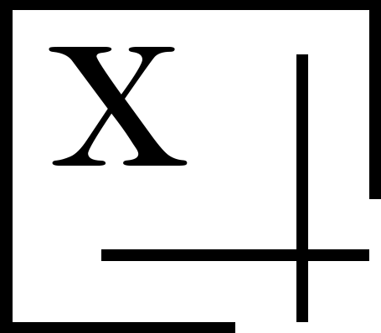
Technologies
1
Graph Databases
3
Big Data Analytics
The Distance Problem
Handling huge volume of data and digesting the information
2
Artificial Intelligence
4
IoT, Cloud
Machine Learning Natural Language Processing
Azure, Remote Health

Slide 5
Graph Databases
Geo Hashing
Create nodes in the graph
database
Create edges with Road distance
Run Single Source Shortest Path (SSSP) algorithm (a.k.a delta stepping)
Graph database – neo4j
Query Language – Cypher
Data loader - .NET Core
We loaded New York area. 170k providers and 30% of area in new York covered.
Route is bidirectional (for now), but reality could be different.
Standard base32 encoding contributed by Chris Veness.
Geo Hashing level 7 is used which has 193 x 193 meter accuracy.
Google distance matrix API for distance between two geo hashes
Neo4j enterprise service available with all leading cloud vendors including Azure, AWS.

Slide 6
Try
Install Neo4j (Open Source)
Write a simple .NET / Java program to store and retrieve data
Remember Hello World

Slide 7
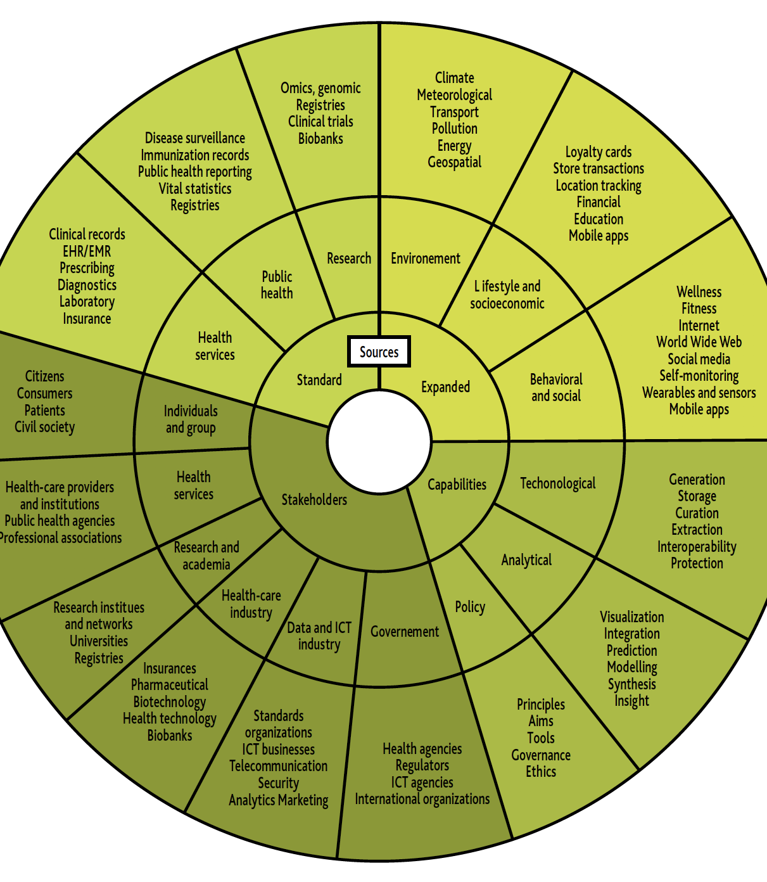
Is Big Data really Big

Slide 8
Bigdata Analytics
https://medicalreferrals.com/cmr/#/standard-reports/PracticeReferralSummary

Slide 9
Try
Install MongoDB (Open Source)
Download Doctor data as a csv file(https://npiregistry.cms.hhs.gov/)
Use a .NET / Java Program to insert the data into MongoDB

Slide 10
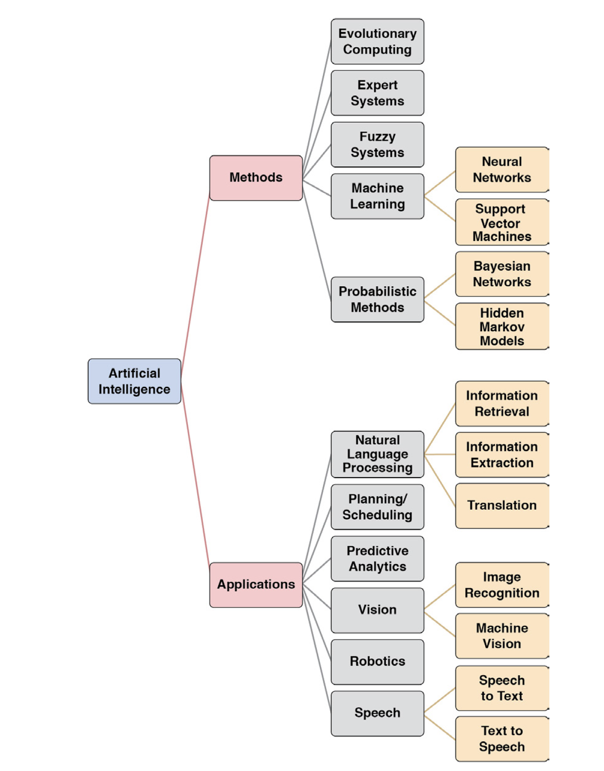
Artificial Intelligence

Slide 11
Artificial Intelligence
Natural Language Processing
https://www.algolia.com/realtime-search-demo/st-peters-college-natural-language-search-demo
https://www.algolia.com/apps/VRVN47NBUJ/explorer/ui-demos/NPPES

Slide 12
Artificial Intelligence
https://studio.azureml.net/Home/ViewWorkspaceCached/2e0f09f4888a4ebaae0064be199761d4#Workspaces/Experiments/Experiment/2e0f09f4888a4ebaae0064be199761d4.f-id.6c1486511ed7472495a0516515ab0b14/ViewExperiment
https://www.youtube.com/watch?v=AkTmABP_8Go

Slide 13
Try
Use Algolia API’s to load your own data and search for it
Use ML Studio by Microsoft and create a basic Machine learning Model

Slide 14
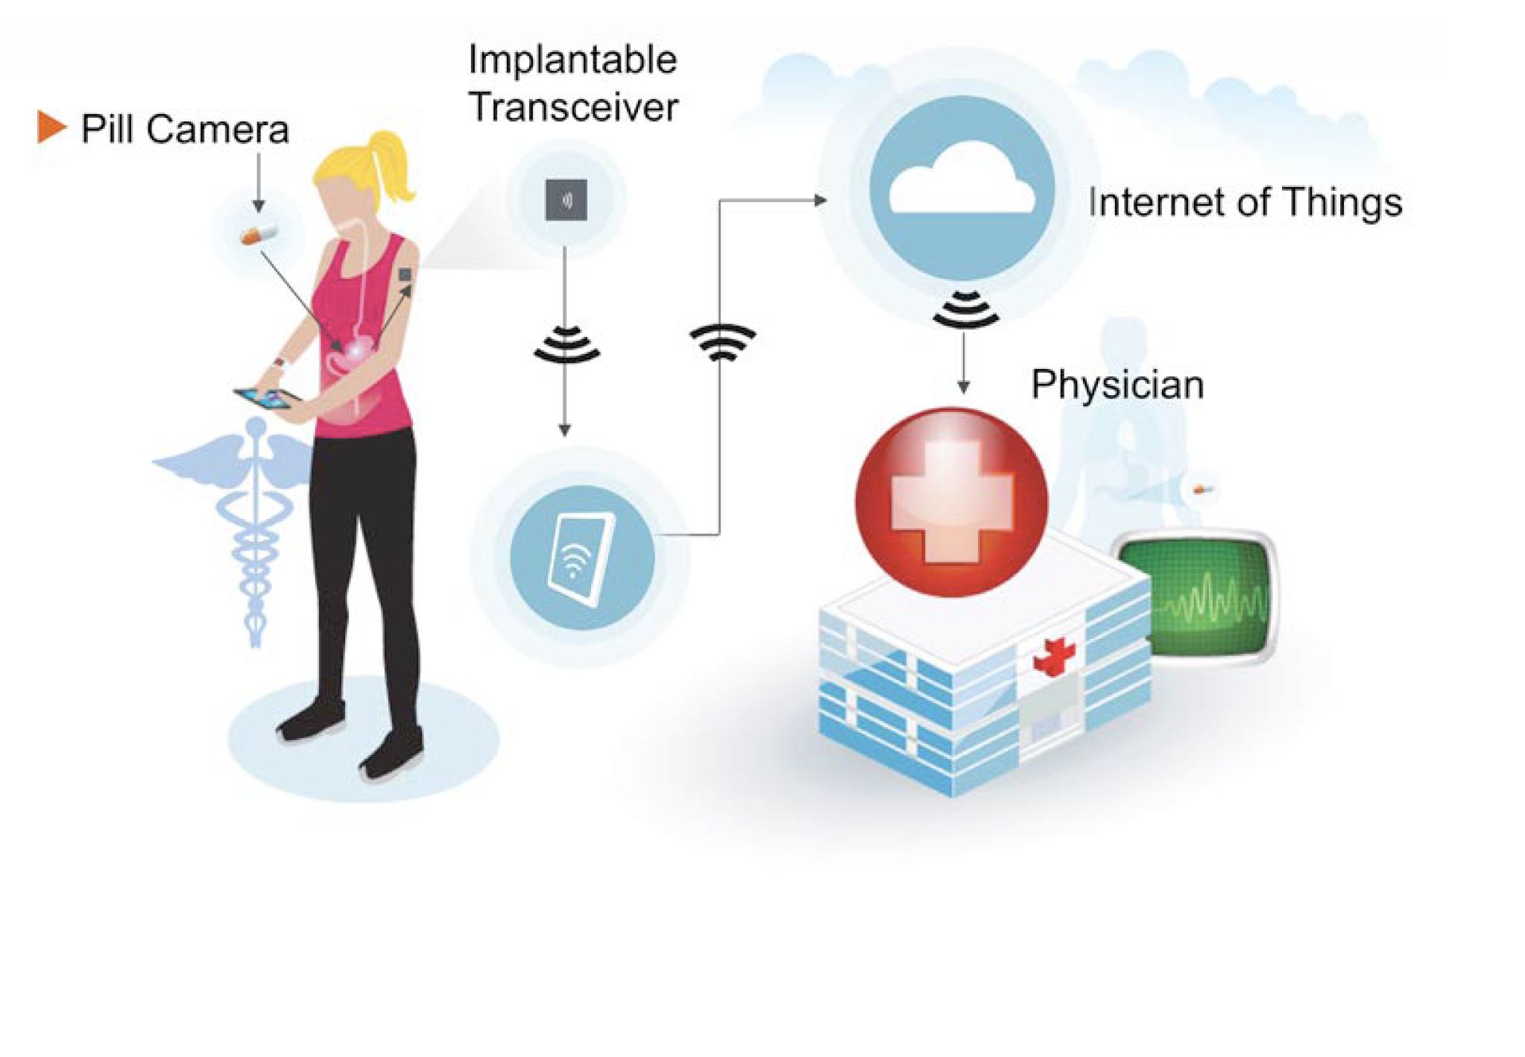
Tele Health - IoT

Slide 15


Slide 16
86% (2.4 trillion) on chronic conditions
Why IT matters
Life expectancy is 78
Leading a happy life is good for humanity

Slide 17
Thanks @Soundararajan https://soundararajan.in soundararajan@outlook.com

